Slide 1
Dissecting a Scientific Paper
Gladstone Weekly Intern Session #1
24 June 2016

Slide 2
Outline
The 5 W’s of literature review
Structure of a research article
What is the basic format of each section?
What is the author’s purpose in each section?
What should you as a reader take away from each section?
How to apply these skills
Objectives:
Develop your scientific literacy: search, dissect, present, and evaluate
Apply the lessons on what makes a good paper to your own work
Notes:
How long do you think it would take you to read this paper from start to finish and present it to your mentor?

Slide 3
The 5 W’s of literature review
Who?
PIs, trainees, institute directors
Clinicians
Patent attorneys, educators, journal editors, etc
What?
Original research article
Clinical study or case
Review or perspective
Textbook chapter
When?
Always!
Notes:
Everyone whose work is affected by the science
Basic types of literature

Slide 4
The 5 W’s of literature review
Where?
Specific topic searches: www.pubmed.gov
Citations from review papers or introductions
Journal clubs & seminars
Email alerts from Pubmed, journal tables of contents, or news sources
Storage: Mendeley
Why?
Get familiar with a new field
Develop new hypotheses
Make informed decisions
Stay on top of the field
Put your research in context
Learn how to write about your own research
Notes:
Pubmed: try out “Advanced Search” and “Create Alert”
Narrowing example: Alzheimer’s disease => + amyloid => + secretase => review, full text => Selkoe paper (#8) => Selkoe DJ => Alzheimer’s disease
Mendeley: keywords, highlights, notes (APP => Verret)

Slide 5
Your turn!
Your mentor has assigned you to study how Zika virus causes microcephaly using mice as a model.
You find a paper published online earlier this month about Zika in mice…

Slide 6
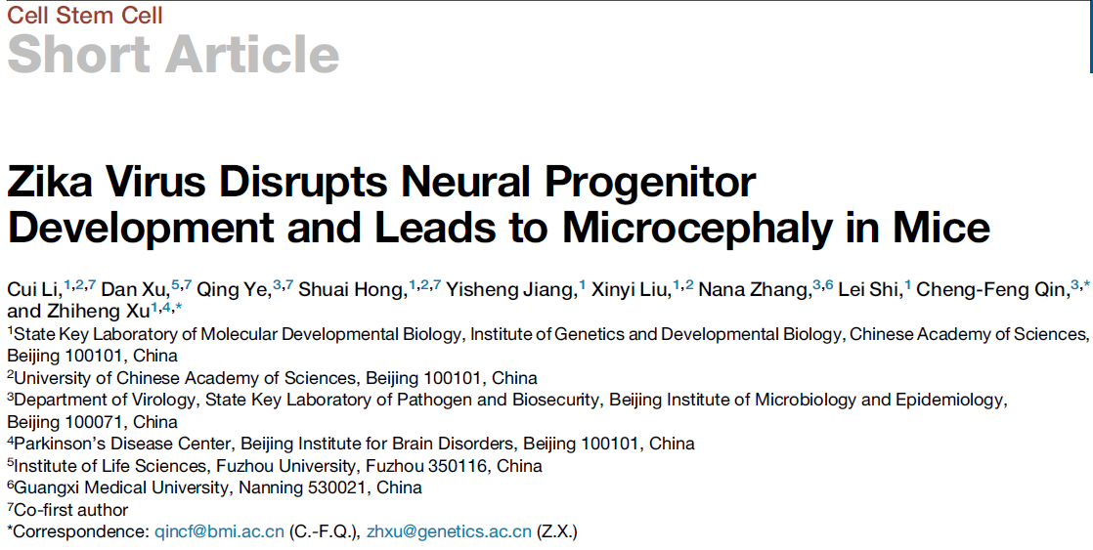
Title
Concise, descriptive, contains important keywords, and conveys major finding
Notes:
Think about the keywords and findings and try drafting a title to your project
Look up the journals in your field
Think about who the authors on your poster will be

Slide 7
Abstract
Basic structure: background → purpose & question → method → major findings → importance
Author’s purpose:
Your project in 100-250 words
The only part of the paper that most people will read
Reader’s purpose:
Skim the paper for major findings* and relevance
Identify and define vocabulary terms or methods you are unfamiliar with
Notes:
*caveat: watch out for nuances and contradictory studies, don’t take it as absolute truth

Slide 8
Introduction
Basic structure: a few paragraphs of crucial literature review that narrows in scope from what is known in the field to specific critical findings to your hypothesis
Authors purpose: provide enough background for readers to understand the article and its importance
Reader’s purpose:
Learn background material and find new papers to read
Continue to identify keywords and methods to look up
Sketch out the known and the unknown

Slide 9
Methods
Basic structure: often given briefly in results or figure legends and in detail at end of paper, in supplement, or in cited papers
Author’s purpose: provide enough detail to replicate the experiment
Reader’s purpose:
What does this assay really measure?
Is this assay appropriate for the measurement? What are its limitations?
Do I trust the results based on the experimental design?
How does this relate to methods I use?
Notes:
Define “assay”

Slide 10
Results
Basic structure: brief methods, major findings, interpretation only; generally divided into one section per figure, with informative subheadings and figure legends
Author’s purpose: tell a story
Reader’s purpose:
What are the major findings?
Under what conditions were the results found?
What are the caveats of this study?
Notes:
Good results flow logically
Walk through the hypothesis, methods, results, criticism of figure 1

Slide 11
Discussion
Basic structure: results summary followed by exploration of conclusions
Author’s purpose:
Draw conclusions* and interpret how the data support them
Address limitations
Put findings in context of the literature and the big picture
Suggest future directions
Reader’s purpose:
How do I interpret these findings?
How important are these findings?
What future experiments should I consider?
Notes:
*pay attention to words like “suggests” and “likely” to note when conclusions are definitive or speculative

Slide 12
How have we used this paper to…
Get familiar with a new field?
Develop new hypotheses?
Learn how to write about your own research?

Slide 13
Literature review in the wild
Identify your purpose
Read the abstract
Scan figures, read results subheadings, read last paragraph of introduction and first paragraph of discussion
Strategic reading: nonlinear and active
Critical reading: applying your own insight

Slide 14
Reviewing our objectives
Develop your scientific literacy: search, dissect, present, and evaluate
Apply the lessons on what makes a good paper to your own work

Slide 15
Material shamelessly adapted from…
Reading a Scientific Article – NIH Office of Intramural Training & Education: https://www.training.nih.gov/assets/Reading_a_Scientific_Paper_Slides_-_508.pdf
How to read a scientific paper – UNC Biology Department: https://bio.unc.edu/files/2011/06/How-to-read-a-scientific-paper.ppt
How to read a scientific article – Rice University Cain Project in Engineering and Professional Communication : http://www.owlnet.rice.edu/~cainproj/courses/HowToReadSciArticle.pdf

